Slide 1
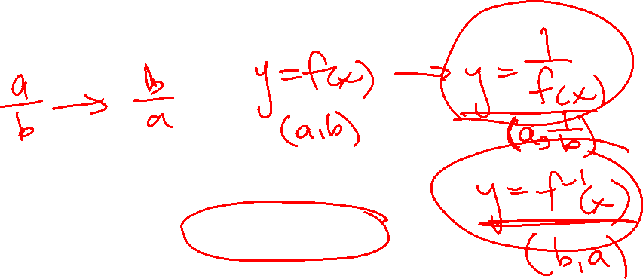
Section 2.7 Reciprocal of Quadratic Functions
i) Concept of Reciprocal Functions
ii) Asymptotes, Invariant Points,
iii) Graphing the Reciprocal of Linear and QF
iv) Domain and Range
© Copyright all rights reserved to Homework depot: www.BCMath.ca

Slide 2
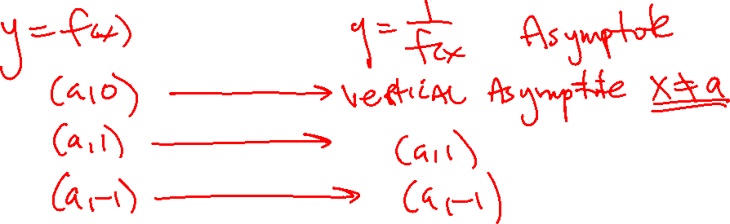
I) What is a Reciprocal ?
A reciprocal is a number you get when switching the value of the numerator (Top) with the denominator (Bottom).
Ex: Find the reciprocal of each number:
Notice that the reciprocal of 1 and – 1 will stay the same
The reciprocal of 0 is undefined
The reciprocal any value between 1 and – 1 will become larger
The reciprocal any value larger than 1 will be smaller
© Copyright all rights reserved to Homework depot: www.BCMath.ca

Slide 3
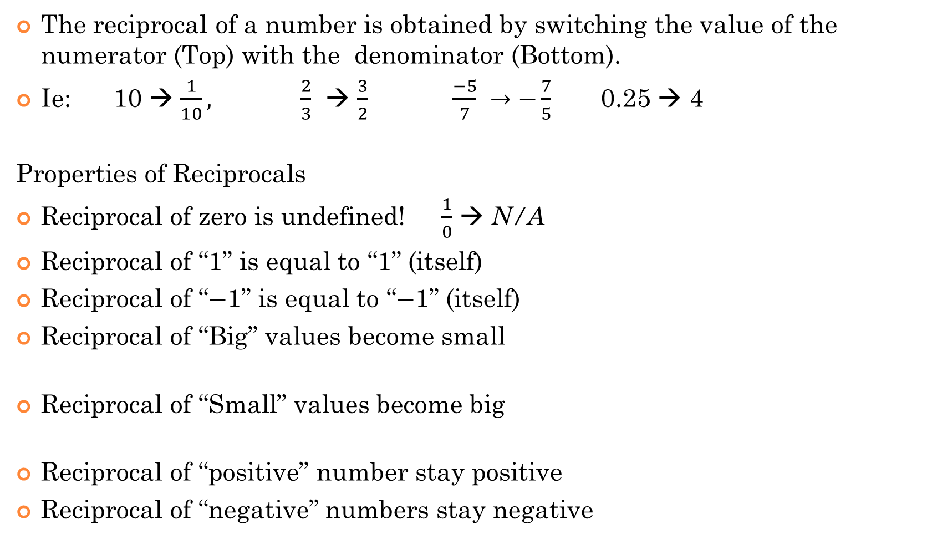
What is a Reciprocal Function?
The reciprocal of a number is obtained by switching the value of the numerator (Top) with the denominator (Bottom).
Ie: 10 → $\frac{1}{10},$ $\frac{2}{3}$ → $\frac{3}{2}$ $\frac{−5}{7} →−\frac{7}{5}$ 0.25 → 4
Properties of Reciprocals
Reciprocal of zero is undefined! $\frac{1}{0}$ → N/A
Reciprocal of “1” is equal to “1” (itself)
Reciprocal of “$−$1” is equal to “$−$1” (itself)
Reciprocal of “Big” values become small
Reciprocal of “Small” values become big
Reciprocal of “positive” number stay positive
Reciprocal of “negative” numbers stay negative

Slide 4
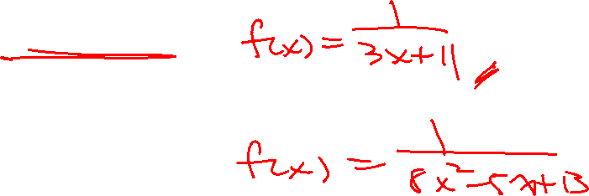
II) Properties of Reciprocal Functions
When taking the reciprocal of a function, the “input” values “x” do not change, they stay the same
The output values “y” are “flipped”, becomes the reciprocal, $\left(x,\frac{a}{b}\right) →$ $\left(x,\frac{b}{a}\right)$
The reciprocal of a function is obtained by taking the original function, put in the denominator, and place a “1” in the numerator
© Copyright all rights reserved to Homework depot: www.BCMath.ca

Slide 5
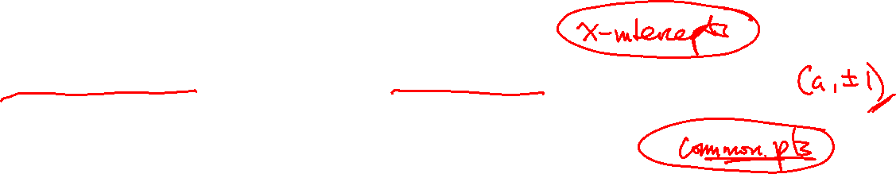
iii) Graphing Reciprocal Functions
The reciprocal function takes the reciprocal of all the y-coordinates of a function
When graphing a reciprocal function, there are a three main steps:
The reciprocal of zero is undefined, so points with a y-coordinate of zero will become a vertical asymptote
The reciprocal of 1 or -1 will be the same, so points with a y-coordinate of 1 will not change
Take the reciprocal of all y-coordinates to find where the points of the new function is.
Reciprocal of large numbers become small
Reciprocal of small numbers become large
© Copyright All Rights Reserved Homework Depot www.BCMath.ca

Slide 6
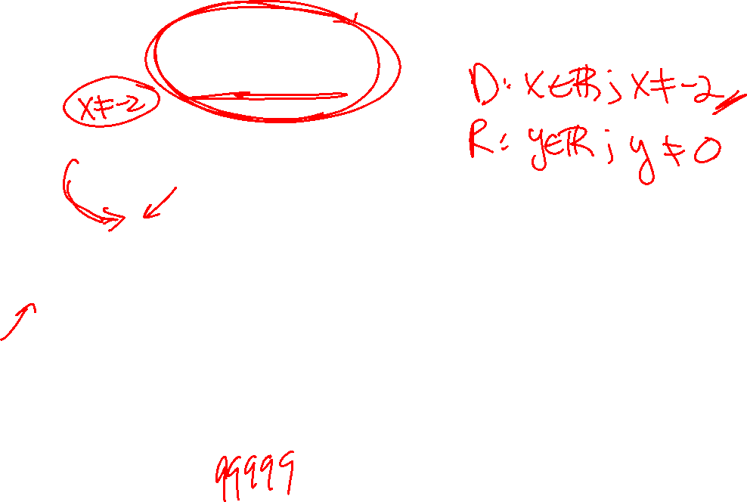
Ex#1) Graph
1. First graph the line:
4. Take the reciprocal of the Y coordinate for every point
y = 0.5x+1
2. Find X-intercept (when y = 0) → Vertical Asymptotes
3. Find Common Points: Points where the Y-coordinate is 1 or -1
© Copyright all rights reserved to Homework depot: www.BCMath.ca

Slide 7
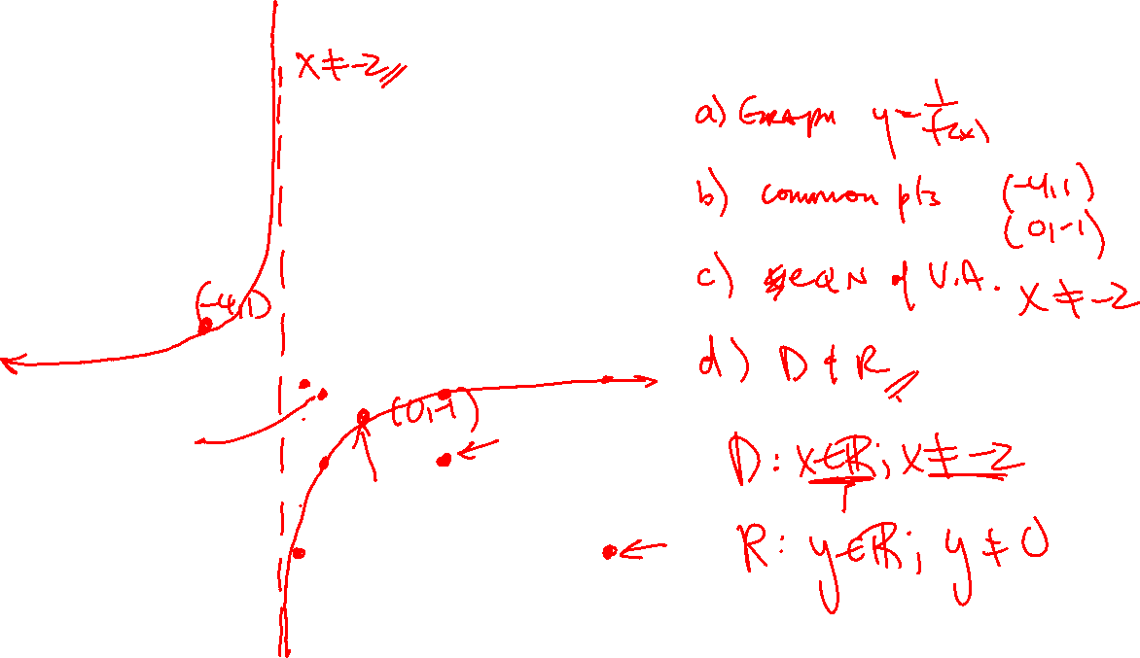
Practice: Given the following graph, draw the reciprocal function
y
Find the x-intercept → Vertical Asymptote
5
Find common points with a
Y-coordinate of 1 or -1
Pick some points on the original
Function and take the reciprocal
of the Y-coordinate
x
-5
0
5
Reciprocal of large numbers will become small
Reciprocal of small numbers
will become large
-5
© Copyright All Rights Reserved Homework Depot www.BCMath.ca

Slide 8
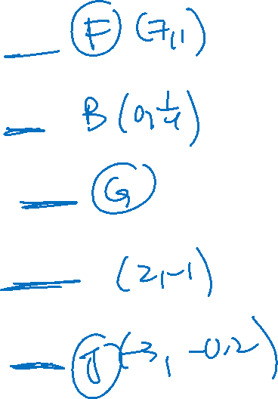
Ex: Given each coordinate on the left, match it with the corresponding point on the reciprocal function:

Slide 9
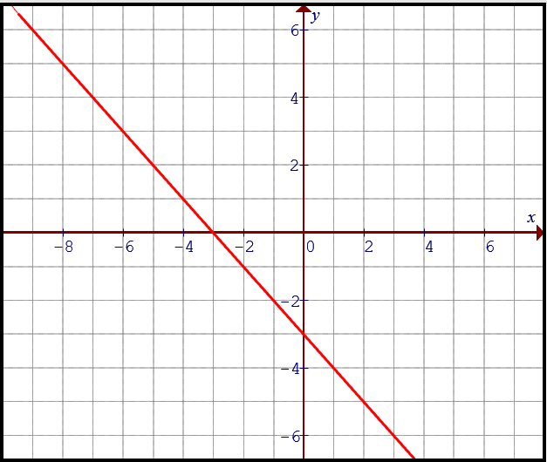
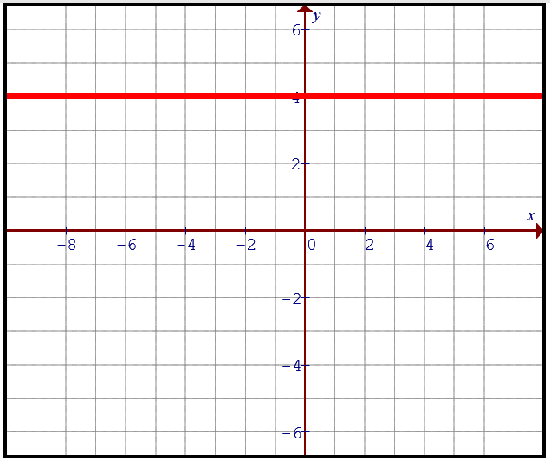
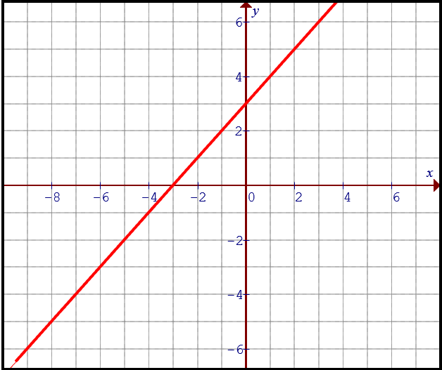
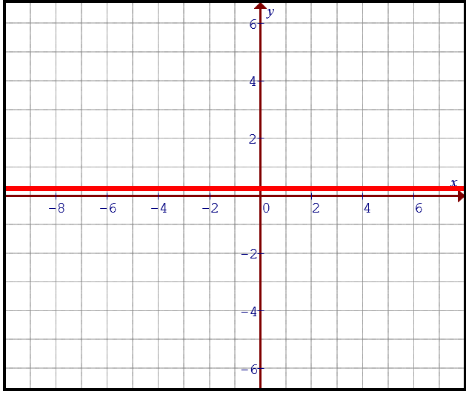
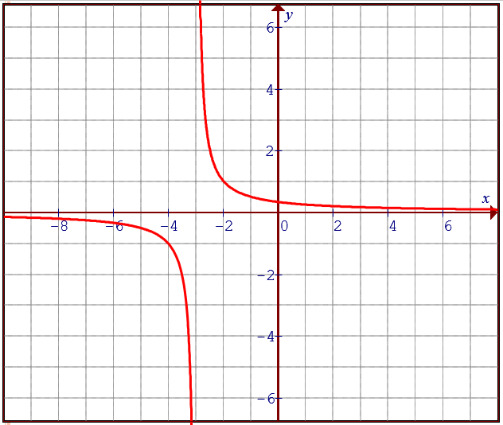
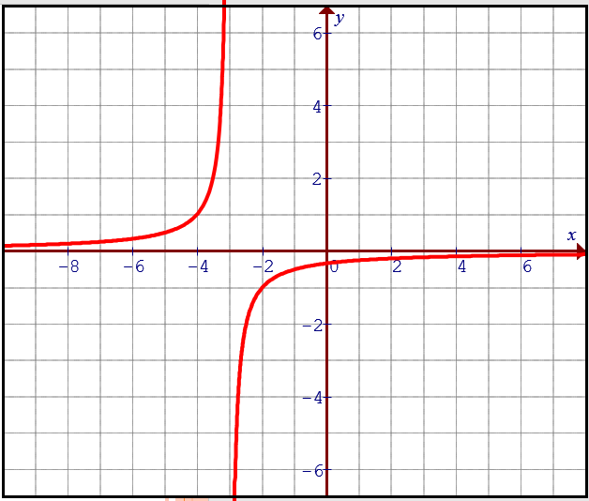
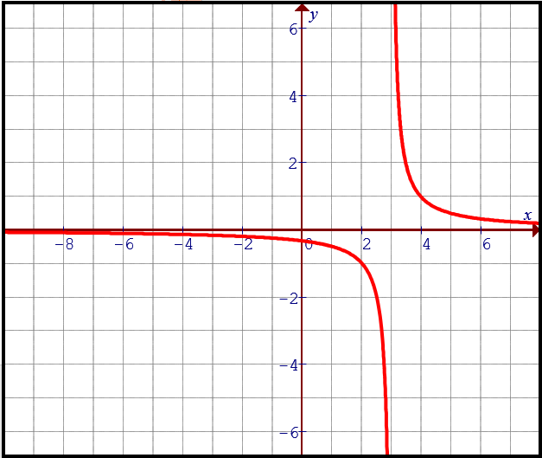
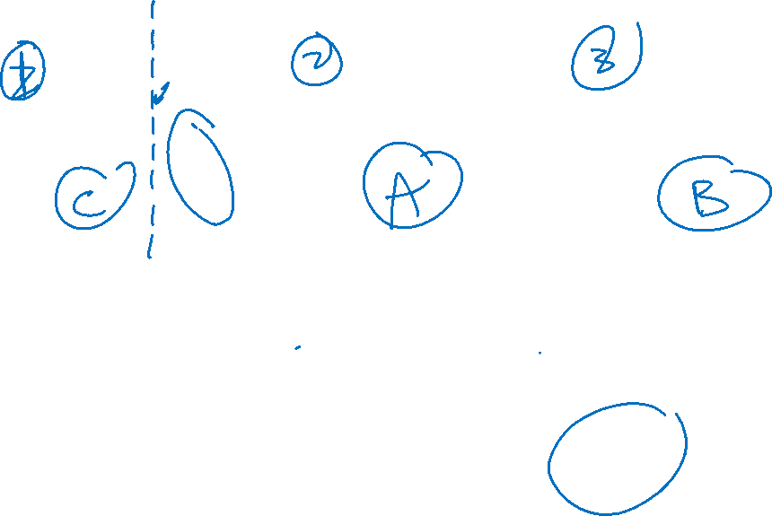
Ex: Please match each graph on top with the corresponding reciprocal function below:
A)
B)
C)
D)

Slide 10
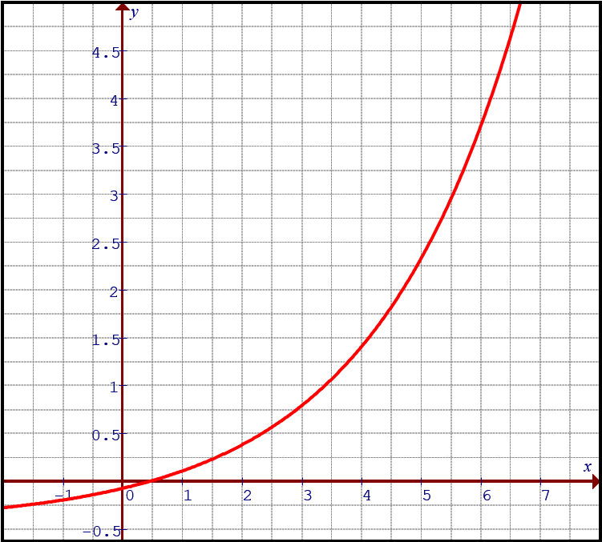
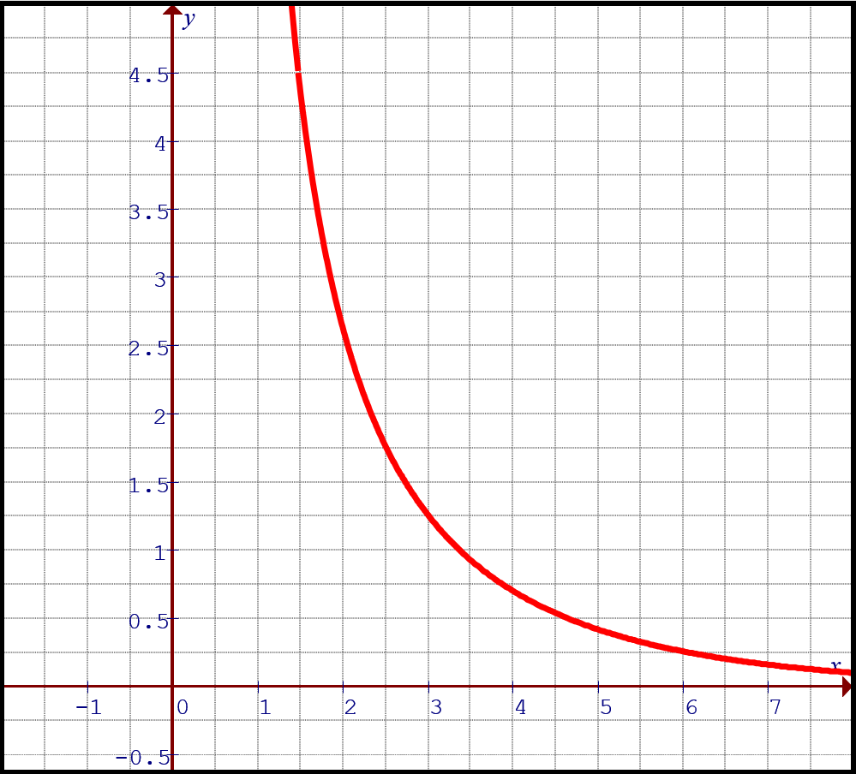
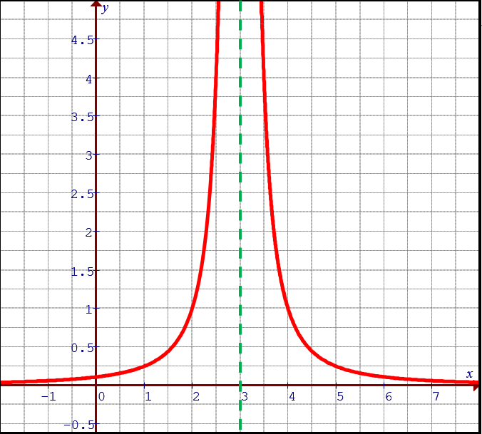
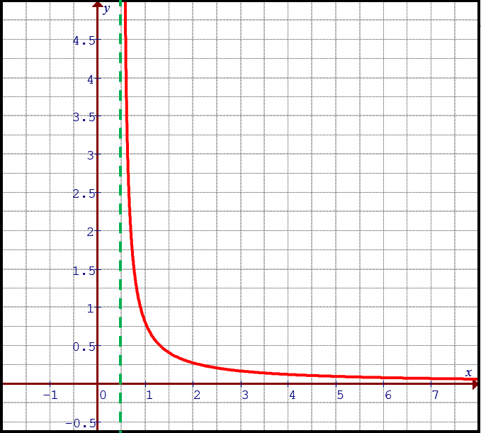
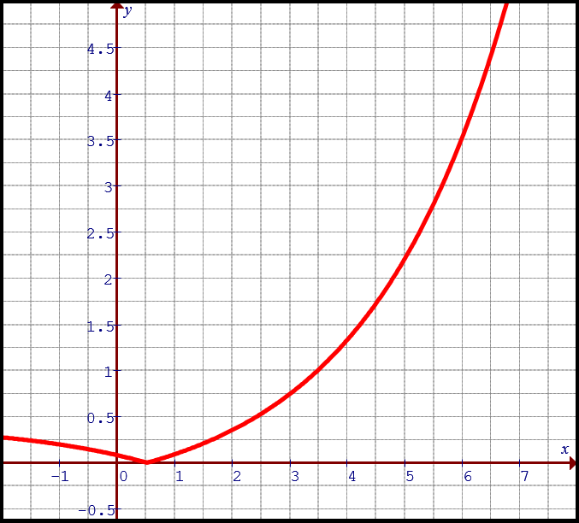
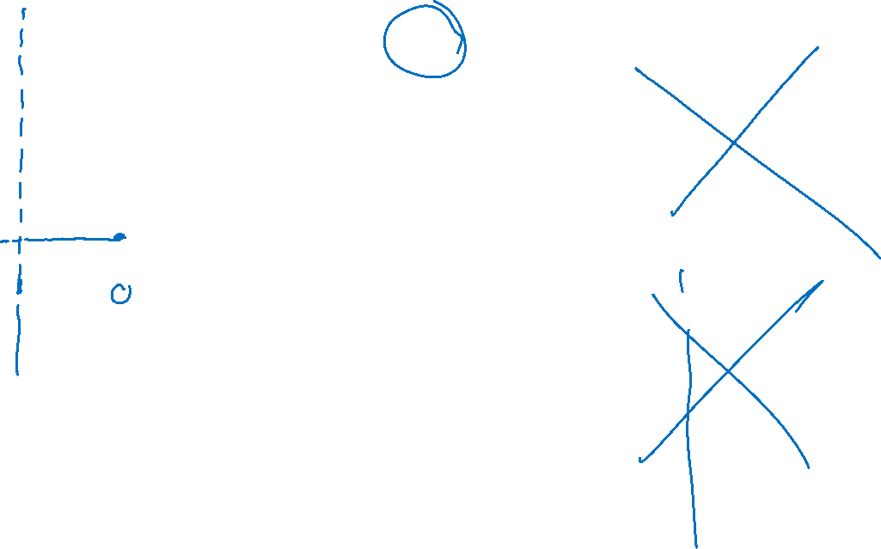
Ex: Given the following points on the curve, which of the following is the reciprocal of the given graph?
A)
B)
C)
D)

Slide 11
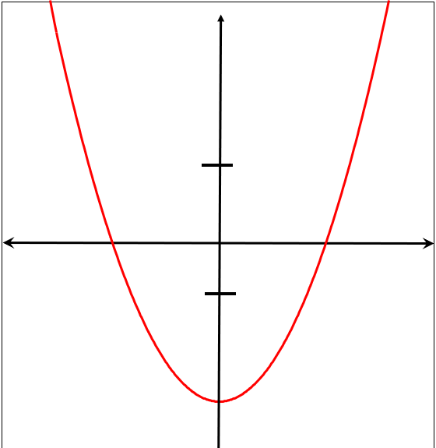



Graphing the reciprocal of a Quadratic function:
1. If a quadratic function has two X-intercepts, then each of those x-intercepts will become a vertical asymptote
2. Common points occur when the y-coordinate is either 1 or -1. So a parabola can have up to four common points.
You will two in the middle and one on the left and right
3. You will have 3 parts when drawing the reciprocal: LEFT, MIDDLE, and RIGHT.
4. Draw the reciprocal starting from the asymptote.
5. Near → Far, Far → Near (with respect to X- axis)

Slide 12
Practice: Graph the following
y
Pick some points on the original
Function and take the reciprocal
of the Y-coordinates. Reciprocal of large numbers will become small
Reciprocal of small numbers
Will become large
Graph
5
Find X-intercept →Asymptotes
x
Find the Common Points where Y coordinate is 1 or -1.
-5
0
5
-5

Slide 13
Graph the reciprocal of each parabola
y
y
5
5
x
x
-5
0
5
-5
0
5
-5
-5
Use the first x-intercept to draw the
Vertical asymptote
There are no x-intercepts, so no VA
Only one invariant point
Plot the invariant points
Graph each side of the asymptote
© Copyright all rights reserved to Homework depot: www.BCMath.ca

Slide 14
Ex#) Given the following graph f(x), graph the reciprocal function.
Find X-intercept →Asymptotes
Find Common Points
Near to Far & Far to Near
© Copyright all rights reserved to Homework depot: www.BCMath.ca

Slide 15
Given the following function, Find equation of all the vertical asymptote, Coordinates of Invariant points, and indicate the domain and Range:
© Copyright all rights reserved to Homework depot: www.BCMath.ca

Slide 16
Given the following function, indicate the domain and Range:
To find the domain of the reciprocal function, we need to get the “X” intercepts of the function in the denominator
The x-intercept of the linear function is at (4/3,0), this is where the vertical asymptote will in the reciprocal function!
y
5
x
To get the range of the reciprocal function, we need to visualize the function in the domain
-5
0
5
-5

Slide 17

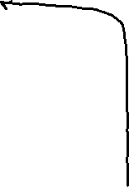
Given the following function, indicate the domain and Range:
To find the domain of the reciprocal function, we need to get the “X” intercepts of the function in the denominator
There are two x-intercepts, which will result in TWO vertical asymptotes
y
10
To get the range of the reciprocal function, we need to visualize the function in the domain
x
-5
0
5
B/c of the negative sign, we have a vertical reflection!
Make sure to include the reciprocal of the vertex!!!!
-10

Slide 18
Given the following function, indicate the domain and Range:

Slide 19
Given the following function, indicate the domain and Range:

